Slide 1
Banking Campaigns Comparator
How Belgian banks communicate similar products differently,
and what ING can learn from it.
Two-week proof of concept for ING DACI / Customer AI
Siegried (marketing framework) · Dan (collection, extraction) · Stephane (analysis, GenAI)
14 – 25 September 2026 · 14 banks · 18 current-account pages of 52 collected · 104 features

Slide 2
The brief, and the constraint that shapes everything
• Compare how Belgian banks communicate comparable products
Campaign pages only: the open web, one language, one product family at a time.
• Turn that comparison into advice ING can act on
Measured differences, argued from named features — not opinion dressed as data.
• The hard constraint: no performance data exists
No clicks, no conversions, no sales. So nothing here may claim that a design choice caused an outcome.
• Therefore every recommendation is a hypothesis to test
The project's value is a defensible, repeatable measurement — and an honest statement of its limits.
This single constraint drives the guardrails you will see on every slide that follows.
Banking Campaigns Comparator · ING DACI / Customer AI · September 2026
2

Slide 3
What we built, end to end
• A measurement pipeline: 14 banks, 52 pages across 6 product families (18 of them current-account), 104 declared features, one frozen contract.
• A scoring workflow: automatic extraction, model-assisted extraction, and a human rubric for the 13 judgement features.
• An analysis library: positioning, similarity, category comparison, AI score, cross-sell, plus generated limitations.
• One web UI with ten tabs: four business views (Analysis, Trends, Reputation, Recommendations), the generated-site builder, and six read-only operator views carried over from the Streamlit dashboard.
• Two optional signals, both fenced off from the performance claim: search interest, and news themes.
• A generated ING website: ten pages built from the selected recommendations — an illustration of what a recommendation means in practice, not a proposal for ING's own site.
Each of those pieces is the next few slides; the pipeline diagram overleaf is the map.
Banking Campaigns Comparator · ING DACI / Customer AI · September 2026
3

Slide 4
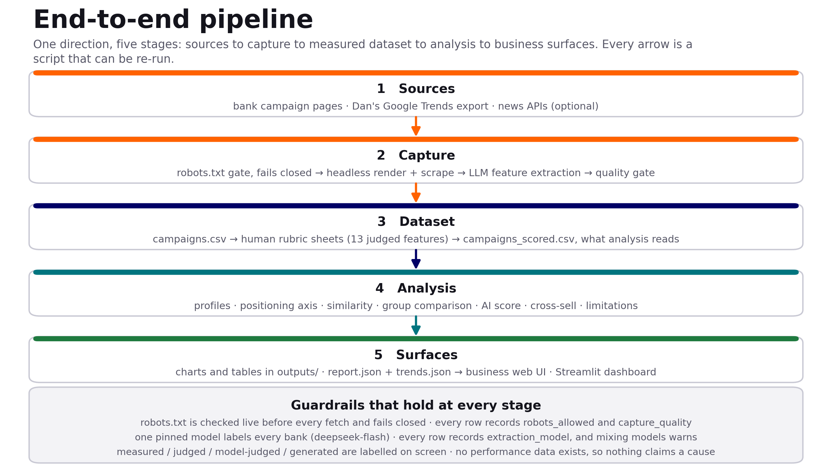
The pipeline, end to end
One direction, five stages. Every arrow is a script that can be re-run; the guardrail band holds at every stage.
Banking Campaigns Comparator · ING DACI / Customer AI · September 2026
4

Slide 5
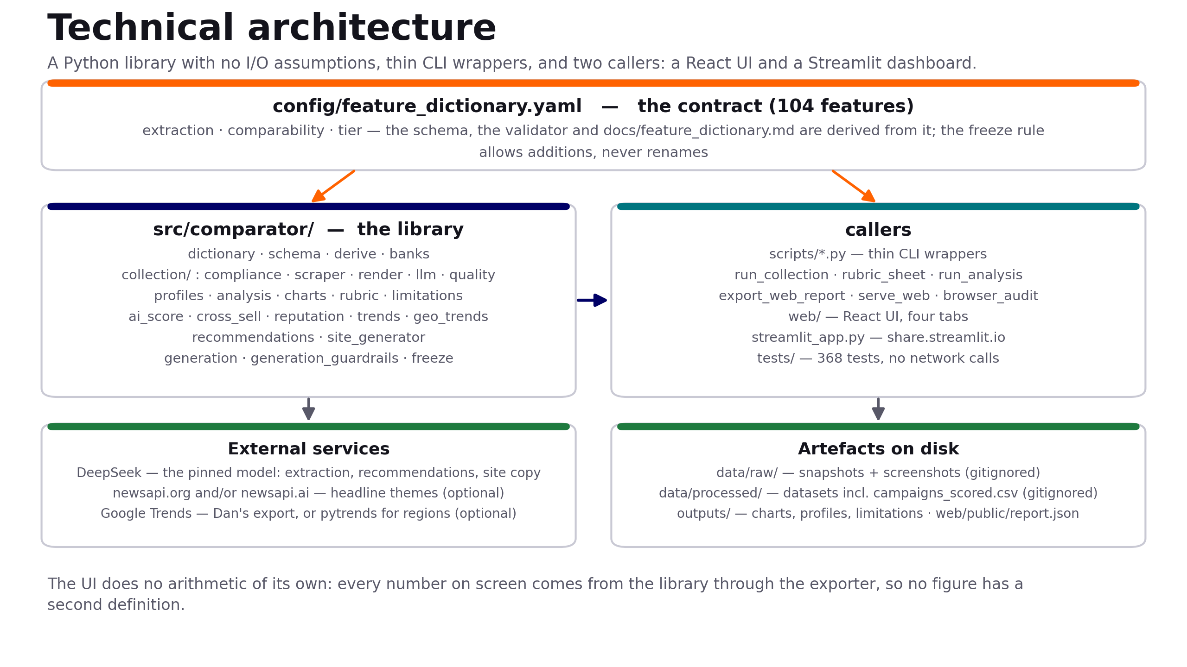
Technical architecture
A library with no I/O assumptions, thin CLI wrappers, and two callers — so no figure has a second definition.
Banking Campaigns Comparator · ING DACI / Customer AI · September 2026
5

Slide 6
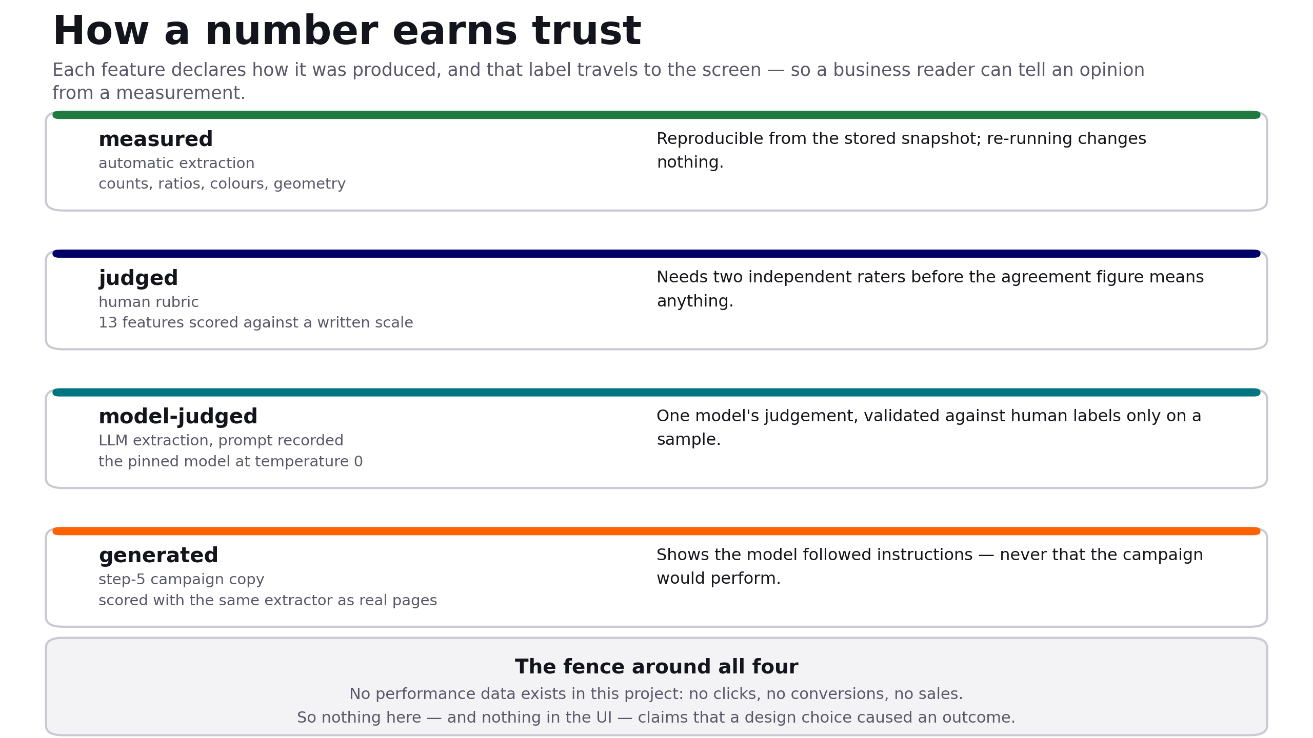
How a number earns trust
Each feature declares how it was produced, and that label travels all the way to the screen.
Banking Campaigns Comparator · ING DACI / Customer AI · September 2026
6

Slide 7
The feature dictionary is the contract
• 104 features, each declaring three things
how it was extracted (automatic / rubric / model-assisted / derived), how it may be compared, and whether it is core or extended.
• Everything else is derived from it
The dataset schema, the validator and the published feature dictionary are generated from the same YAML, so they cannot drift apart.
• The freeze rule: add, never rename
After the Day 2 freeze, columns may be added; renames and removals need all three of us, because analysis code depends on them.
• Two checks, deliberately different
A byte-equality test catches an accidental edit; the semantic freeze check catches a rename that happens to keep the bytes matching.
• It grew twice, legitimately
3 features added after the freeze, and the bank list extended to 12 values — both additions, both recorded.
Banking Campaigns Comparator · ING DACI / Customer AI · September 2026
7

Slide 8
Collection and compliance
• robots.txt is checked live before every fetch, and fails closed
If robots.txt cannot be read, the URL is treated as not allowed. Every row carries robots_allowed; the validator refuses a row where it is false.
• Pages are rendered, not just downloaded
A headless browser reads the page as a visitor sees it, which also fills the geometry features — page height, above-fold elements, image area.
• A quality gate judges the capture, not just the numbers
Two early captures passed every range check while being an empty JavaScript shell and a maintenance notice. capture_quality now travels with the row.
• When a site will not serve us, a person saves the page
BNP Paribas Fortis blocks automated traffic (HTTP 503) and Revolut's headless render is refused; the importer takes a browser-saved page, re-checks robots, and marks it manual_capture.
Banking Campaigns Comparator · ING DACI / Customer AI · September 2026
8

Slide 9
The dataset behind this analysis
• 18 pages, 14 banks, 30 comparable features, nothing excluded
Argenta · Belfius · Beobank · BNP Paribas Fortis · bunq · CBC · Crelan · Hellobank · ING · KBC · Keytrade · N26 · Revolut · Vdk
• Mostly Belgian French — plus two English pages and one Dutch
Word counts and readability are within-language features, so with more than one language present the comparison drops eight of them rather than compare across languages. English was restored on 23/09, after a re-collection had silently lost it.
• Split for like-for-like comparison
10 traditional banks and 4 challengers, compared one product family at a time — a mortgage page and a current-account page differ because the products differ.
• The dataset is in git, alongside the contract
Captures, datasets and outputs are tracked, so any figure on a slide traces back to the exact committed run that produced it.
A snapshot is the honest shape for a finding: true for one dataset, one capture date, one scope.
Banking Campaigns Comparator · ING DACI / Customer AI · September 2026
9

Slide 10
Rubric scoring: people, plus a model as a third rater
• 13 features are judgements, not measurements
Clarity of the offer, layout archetype, AIDA coverage, persuasion levers — scored against a written scale, one sheet per rater.
• Three independent human raters
Siegried, Dan and Stephane each keep their own sheet, split two-raters-per-bank rather than all three scoring all 52 pages. Per-rater counts move within the day; data/rubric/*_scores.csv is the live figure.
• Stephane's sheet is independent since 22/09
It was machine-proposed and adopted until then. Checked directly on 22/09: none of his 13 overlapping pages match the model's output, so he now counts as an independent rater.
• Agreement is measurable for all 13 features, over 9 to 15 pages
Six sit below the module's 60% bar — aida desire 0.00, persuasion levers 0.11, accent locations 0.20, rate prominence 0.27, text-image layout 0.50, and attention 0.55 — so the remaining work is wording, not coverage.
• The model still writes to its own sheet, never a pre-filled one
A pre-filled sheet gets rubber-stamped, and the agreement figure would then measure how persuasive the model was, not how well two people agree.
Banking Campaigns Comparator · ING DACI / Customer AI · September 2026
10

Slide 11
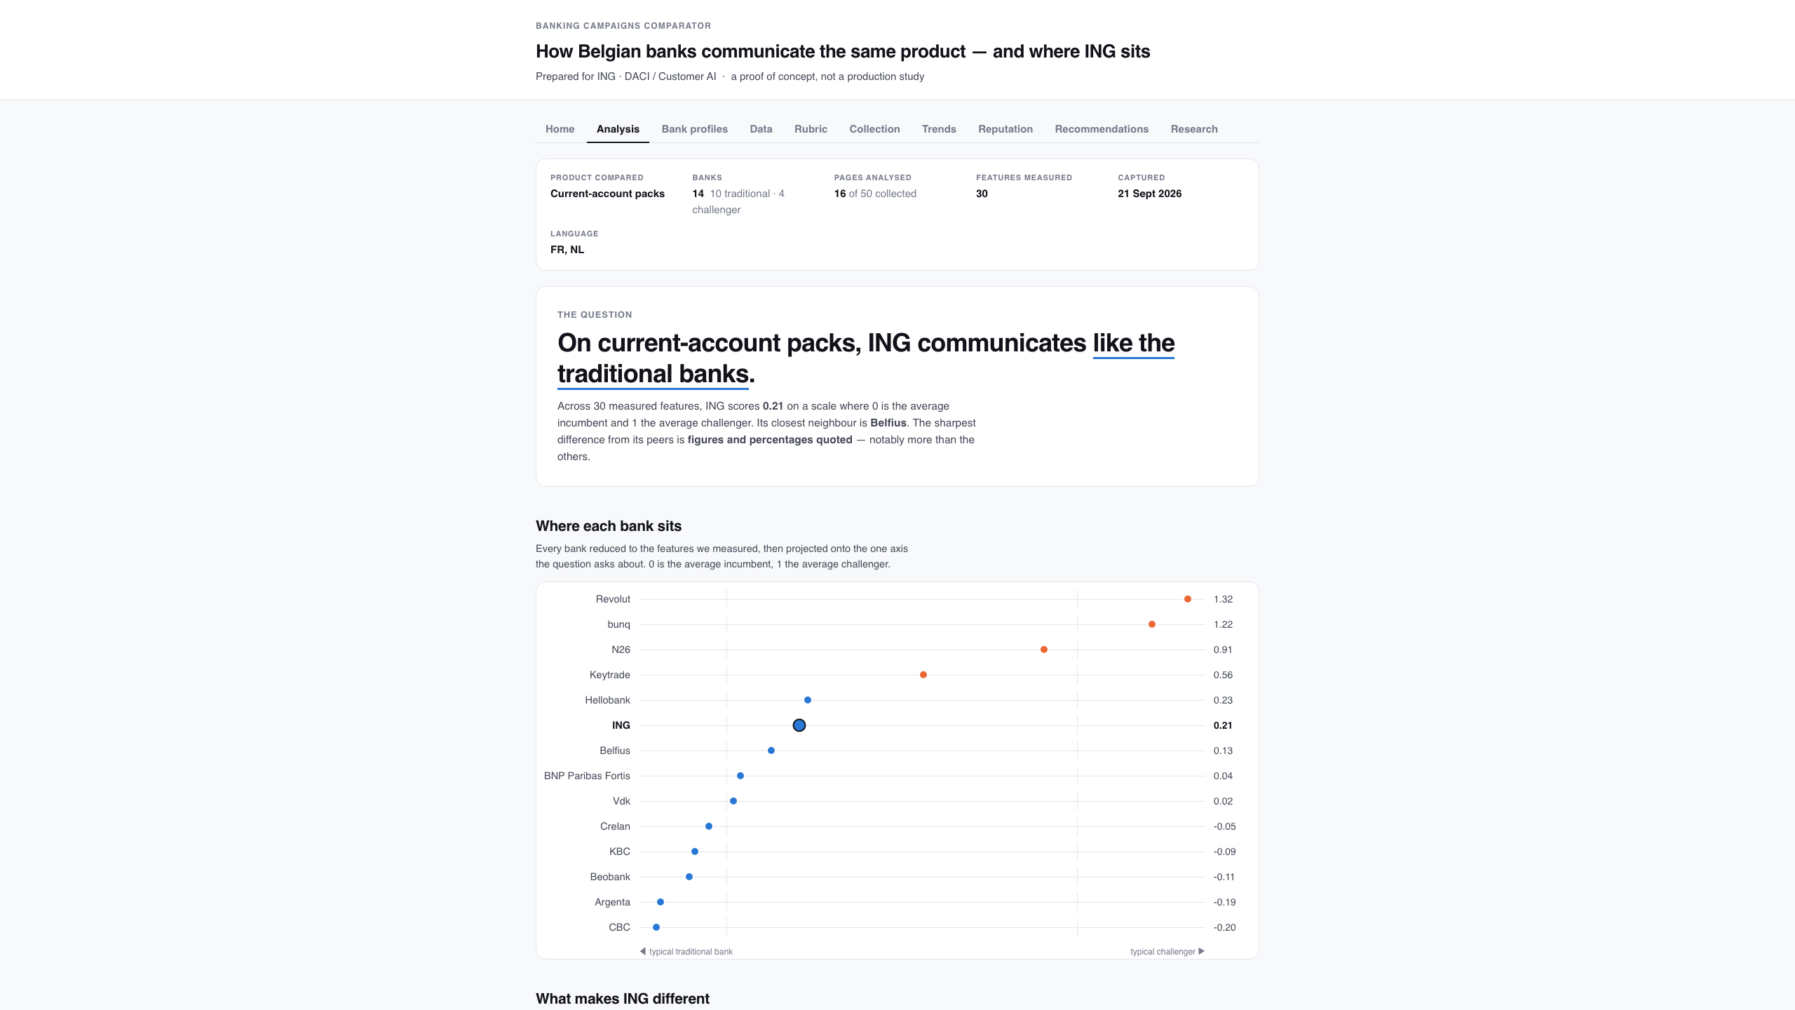
The Analysis tab
Scope, focus and the verdict above the first number — the reader cannot see a figure without seeing what it covers.
Banking Campaigns Comparator · ING DACI / Customer AI · September 2026
11

Slide 12
What the analysis found
• ING sits with the traditional banks, not the challengers
Traditional↔challenger positioning score 0.178 across 14 banks, and its nearest neighbour is Belfius.
• Where ING is furthest above its peers
The offer feels worth having: 4.3 vs peers 3.5 (+1.67 SD, rubric) · Persuasion levers used: 2.3 vs 1.3 (+1.61 SD, rubric) · Claims fast digital onboarding: 0.67 vs 0.15 (+1.42 SD) · Page height: 11,149px vs 6,412px (+1.42 SD) · Page brightness: 0.55 vs 0.34 (+1.40 SD).
• Where ING is below
Calls to action: 0.7 vs peers 5.6 (-1.00 SD) — still the largest negative gap. The earlier "2.0 vs 13.4" came from a counting bug that included navigation and footer links; re-derived 23/09.
• What separates the two groups
Traditional pages are brighter (d = -2.36) and show more without scrolling (d = -2.12); challengers are far likelier to show a rate and to frame the account as a subscription (each d = +2.00), and to target expats (d = +1.23).
• Read as description, not proof
These are descriptive effect sizes over 14 banks, not significance tests — and the rubric-sourced ones moved when the second human sheet was folded in, which is the point of measuring agreement.
Banking Campaigns Comparator · ING DACI / Customer AI · September 2026
12

Slide 13
KBC leads; ING and Belfius are level
KBC
21.30%
Belfius
18.44%
GAP BELFIUS – ING
ING
18.13%
BNP Paribas Fortis
15.40%
0.31 pts
Argenta
9.18%
Crelan
7.07%
Beobank
4.46%
Removing one raw point per week from Belfius brings it to 18.15% — ING’s own figure. Read them as level, not ING in third.
CBC *
2.05%
Revolut
1.64%
VDK Bank *
1.24%
Keytrade Bank *
0.41%
Hello bank! *
0.37%
Incumbents 97.6% · challengers 2.3% of brand search
N26 *
0.29%
bunq *
0.01%
Share of brand search, 261 weeks, Sep 2021 – Sep 2026 · * too low-volume to read share or change
Banking Campaigns Comparator · ING DACI / Customer AI · September 2026
13

Slide 14
Where the banks to benchmark come from
Bank | 2021–22 | 2025–26 | Change | Direction | Selected as
KBC | 21.75% | 20.13% | −1.62 | Down −2.8%/yr | Largest traditional share
Belfius | 18.21% | 18.79% | +0.58 | Flat +0.9%/yr
ING | 19.28% | 16.79% | −2.49 | Down −3.7%/yr | Subject of the study
BNP Paribas Fortis | 17.99% | 13.60% | −4.39 | Down −6.2%/yr
Argenta | 8.32% | 9.42% | +1.10 | Flat +2.0%/yr
Crelan | 5.12% | 8.96% | +3.84 | Up +16.4%/yr | Fastest-rising traditional
Beobank † | 4.38% | 4.34% | −0.04 | Flat −1.3%/yr
Revolut | 0.59% | 3.22% | +2.63 | Up +37.8%/yr | Measurable challenger
Share per 52-week period · flat = within ±2%/yr, a convention, not a test · † direction flips without the first period
Banking Campaigns Comparator · ING DACI / Customer AI · September 2026
14

Slide 15
What their pages share that ING’s don’t
● Mean of KBC, Crelan, Revolut
● ING
Vertical tick = market average (z-score 0)
Images carry alt text
+1.91 vs −0.52
Call-to-action contrast
+1.13 vs −0.34
Animated elements
+0.85 vs −0.55
Selected on search attention alone. This shows what their pages measurably do differently — not why they are searched for.
Pages measured: KBC 3 · Crelan 1 · Revolut 1. Beyond these three choices the brands diverge: no single recipe.
z-scores over the comparable page-feature set · today’s pages, not the pages of 2021–2025
Banking Campaigns Comparator · ING DACI / Customer AI · September 2026
15

Slide 16
Why challengers look small in search
> 1M
1.64%
Revolut private customers in Belgium, +~25,000/month
vs
of brand search, 9th of 14
Navigational searches
App-first journeys
Measurement floor
Incumbent searches include logins, branches, opening hours. A working hypothesis, not verified at query level.
Sign-up via app stores and referral links, then daily app use without searching the name.
Six brands never clear 10/100 in their own request; their share is partly rounding.
Read challenger shares as a floor on attention, not a customer count.
Customer figure: Belga News Agency, 11 Mar 2026 (retrieved 21 Sep 2026) · never compared to a market-share figure
Banking Campaigns Comparator · ING DACI / Customer AI · September 2026
16

Slide 17
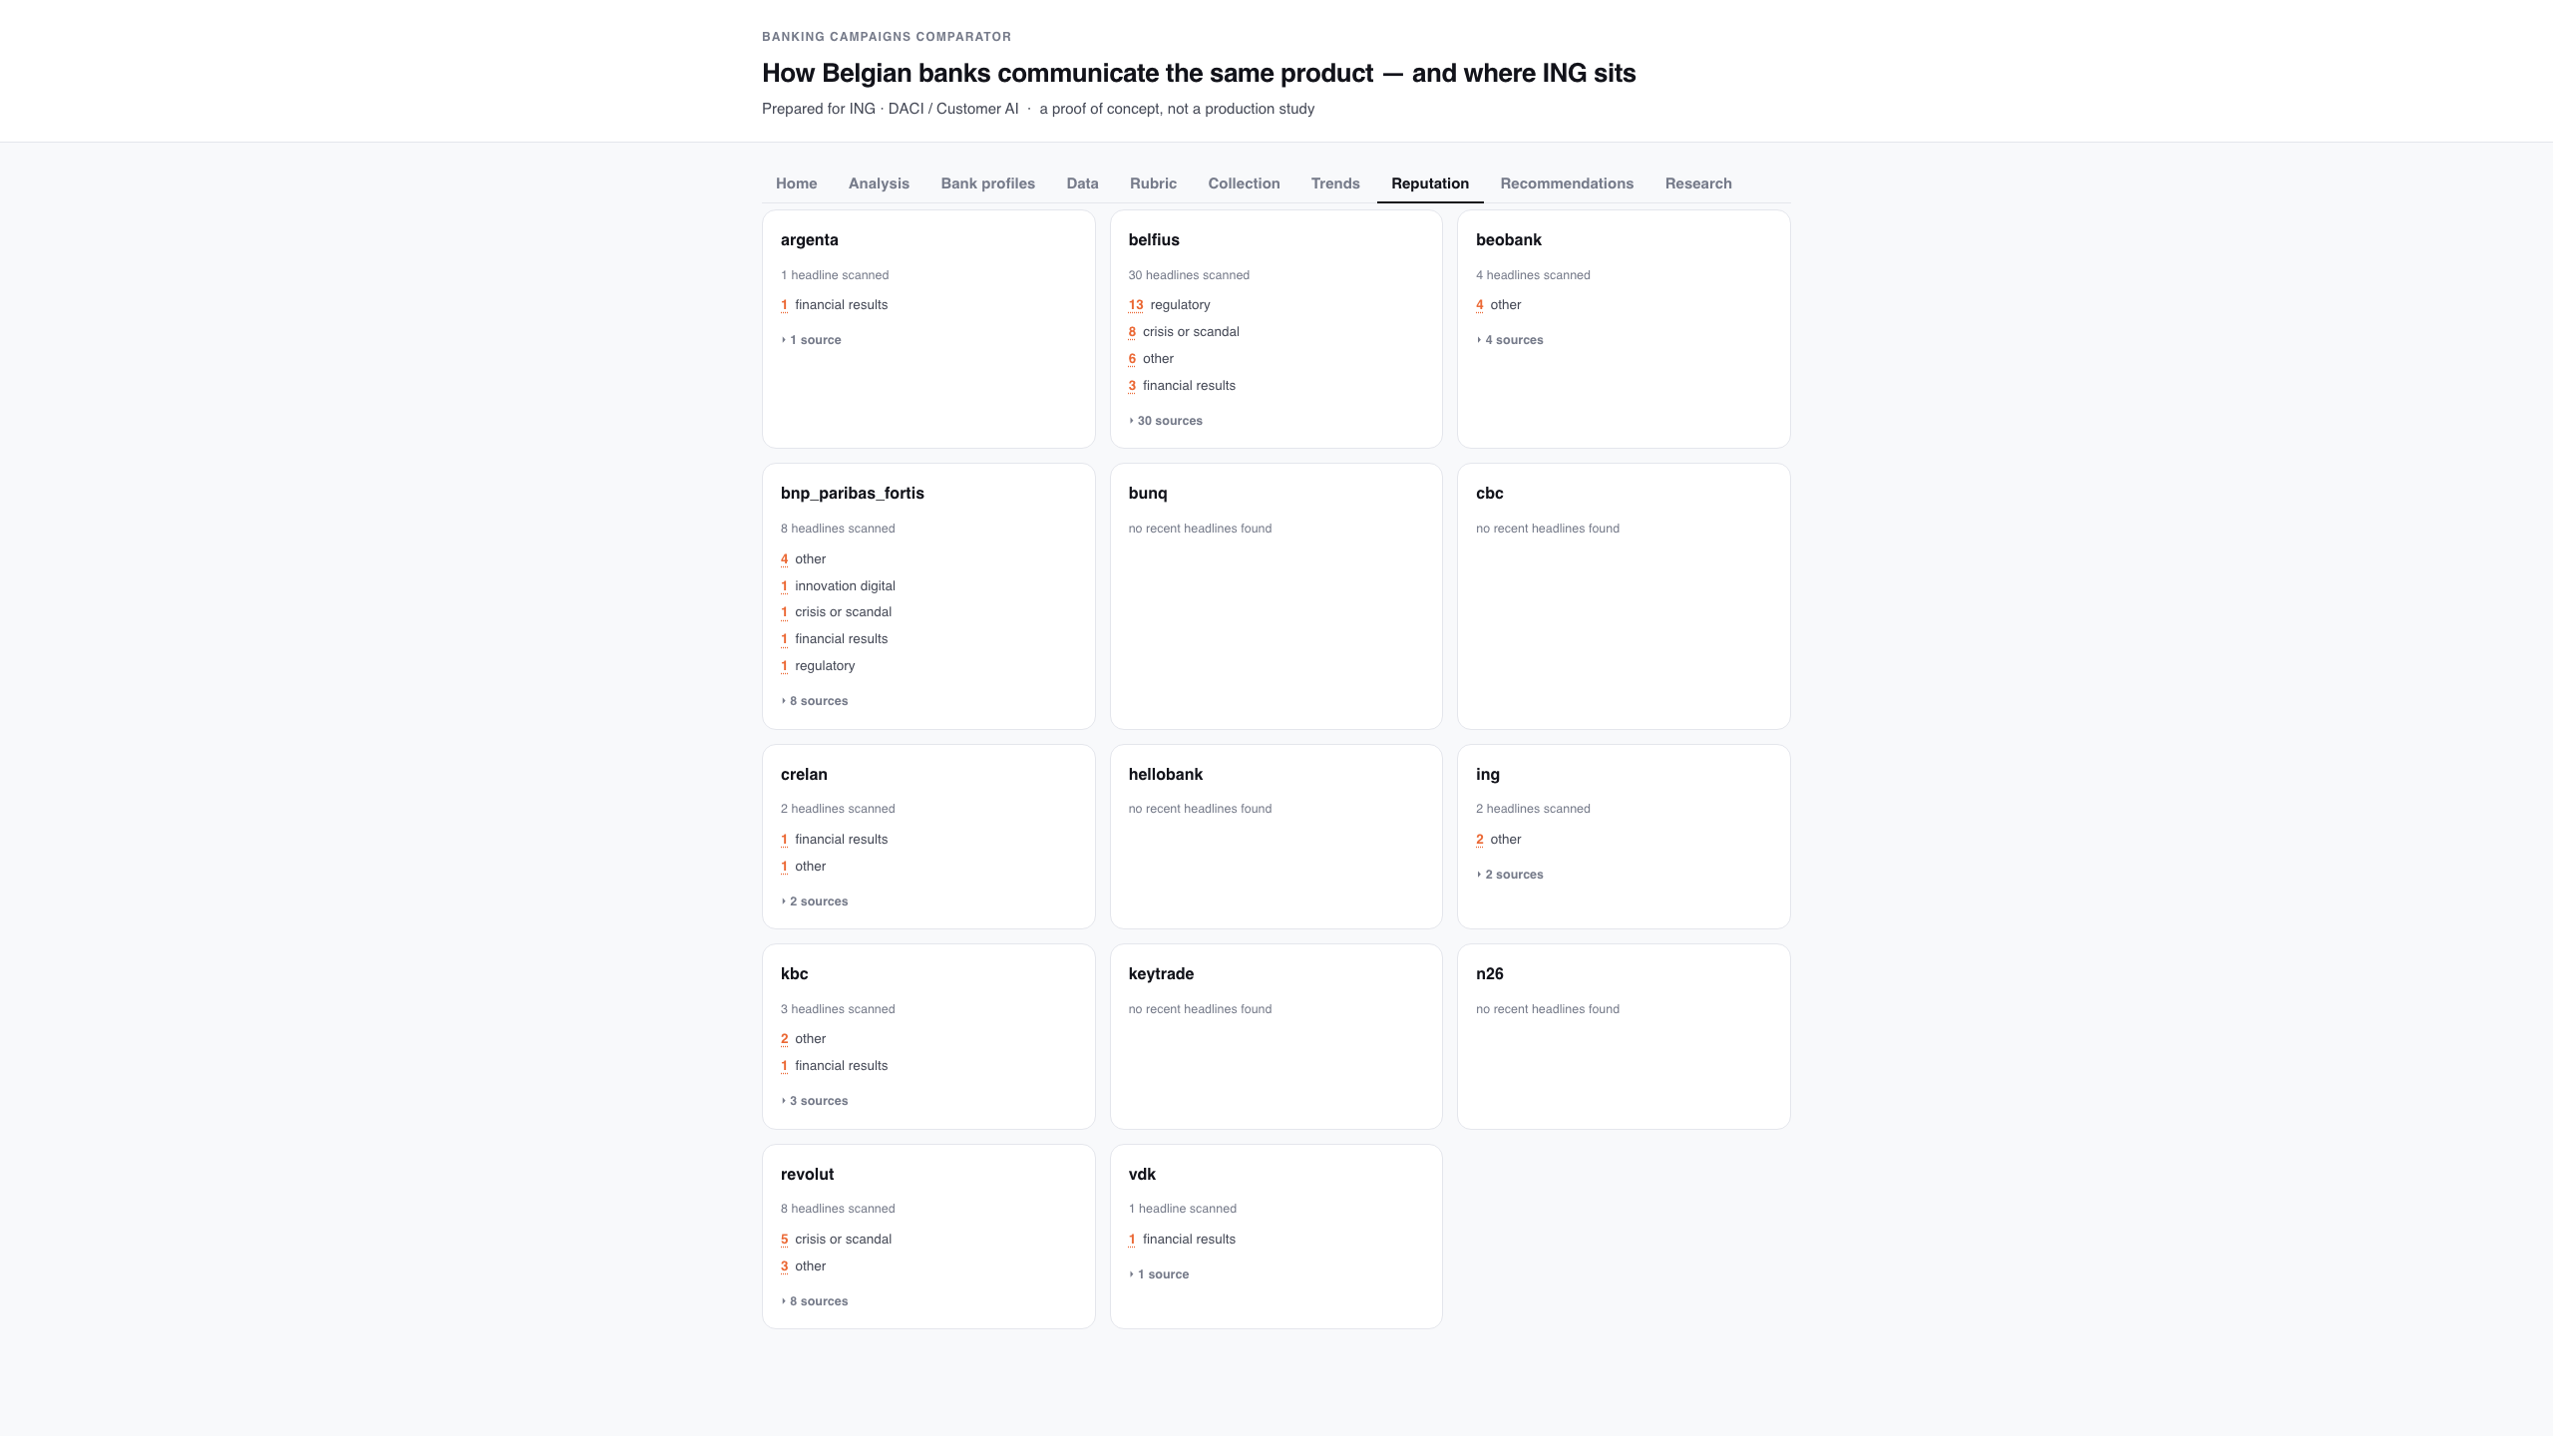
The Reputation tab: what each bank is in the news about
Headline themes — innovation, crisis, results — counted, never scored for sentiment. Two news providers are merged, in three languages.
Banking Campaigns Comparator · ING DACI / Customer AI · September 2026
17

Slide 18
Reputation: themes, not sentiment
• Sentiment scoring was out of scope; themes turn the brief's own 'reputation, innovations, crises' framing into a closed, countable list.
• Two similarly named providers are supported at once (newsapi.org and newsapi.ai); headlines from both are merged and de-duplicated.
• Every provider is queried in English, French and Dutch — Belgian bank news is mostly not in English.
• The module degrades to 'not configured' when no key is present, rather than inventing a number for a bank it has no data on.
• Themes are context about the bank, never evidence that a page or campaign performed. Asked whether reputation shows how well campaigns are doing, the honest answer is no: press coverage says what a bank is written about, not whether its page worked.
Banking Campaigns Comparator · ING DACI / Customer AI · September 2026
18

Slide 19
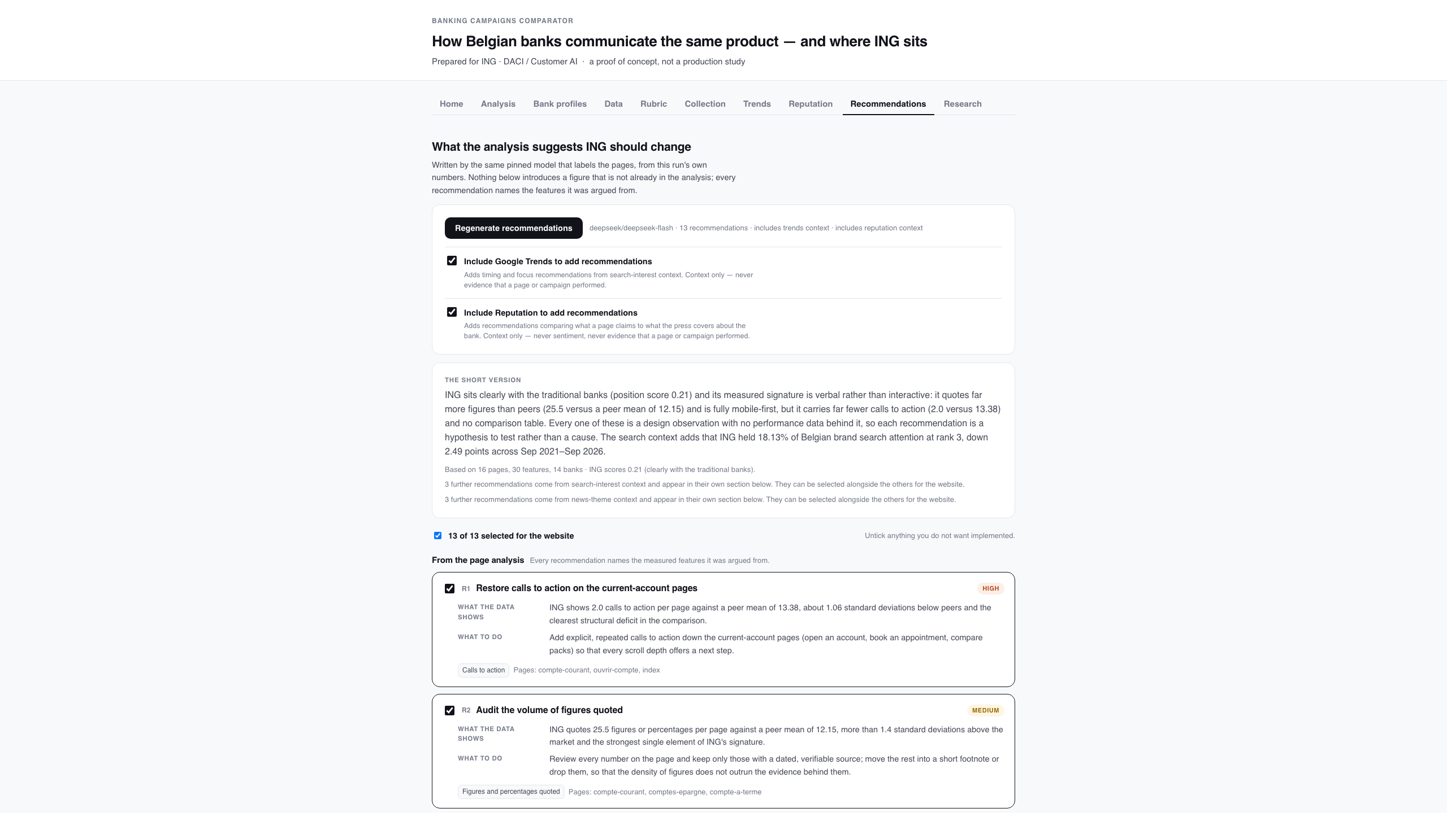
The Recommendations tab
The one place a model is allowed to opine: advice grounded in this run's numbers, each item shown next to the features it was argued from, and selectable.
Banking Campaigns Comparator · ING DACI / Customer AI · September 2026
19

Slide 20
Recommendations, and how they stay honest
• Every recommendation names the measured features it was argued from; an invented feature id is dropped before the list is shown.
• A second, opt-in group can be added from news themes (reputation context).
• The search-interest group was removed on 22/09; Trends now selects three brands on attention alone and the tab reports what their pages measurably do differently from ING's.
• A reader ticks the ones worth building; only the ticked subset reaches the site builder.
• Nothing here re-runs collection or analysis — it reads one report and writes advice.
Banking Campaigns Comparator · ING DACI / Customer AI · September 2026
20

Slide 21
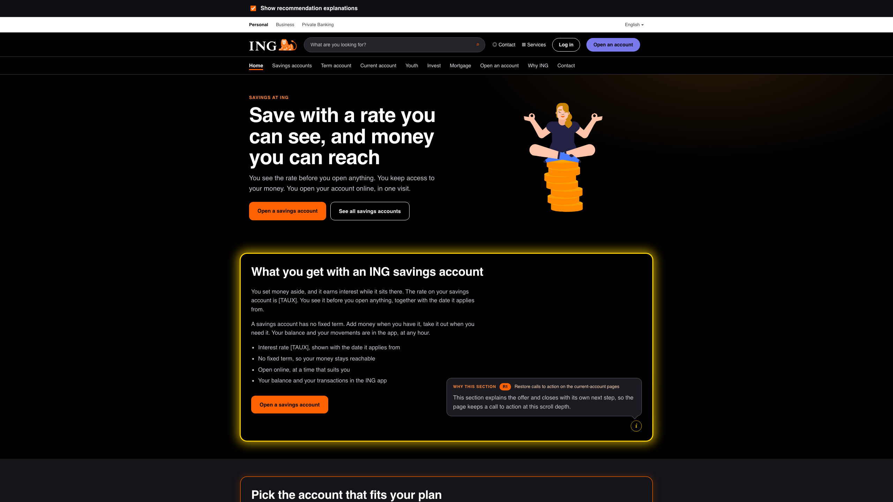
The generated ING website, with explanations on
An illustration, not a proposal for ING's site: each section that implements a recommendation is boxed, the (i) button opens the reasoning above it, and that section's glow switches to a slow yellow flicker.
Banking Campaigns Comparator · ING DACI / Customer AI · September 2026
21

Slide 22
Explanation mode: showing the work
• Tick 'Explain each section' and every generated section that acts on a recommendation is boxed, with an (i) button and a one-sentence rationale in the page language.
• Yellow flicker while an explanation is open — deliberately not ING orange, so the explanation state cannot be mistaken for the brand treatment.
• A switch above the site turns the whole layer off, and the choice is remembered across the ten pages — so the same site can be shown as a normal site.
• Every page gets at least one box; pages no recommendation targets borrow the site-wide advice that applies.
• The first explained run produced copy about the recommendations themselves, so the page prompt now forbids meta copy and confines 'why' to the rationale.
Banking Campaigns Comparator · ING DACI / Customer AI · September 2026
22

Slide 23
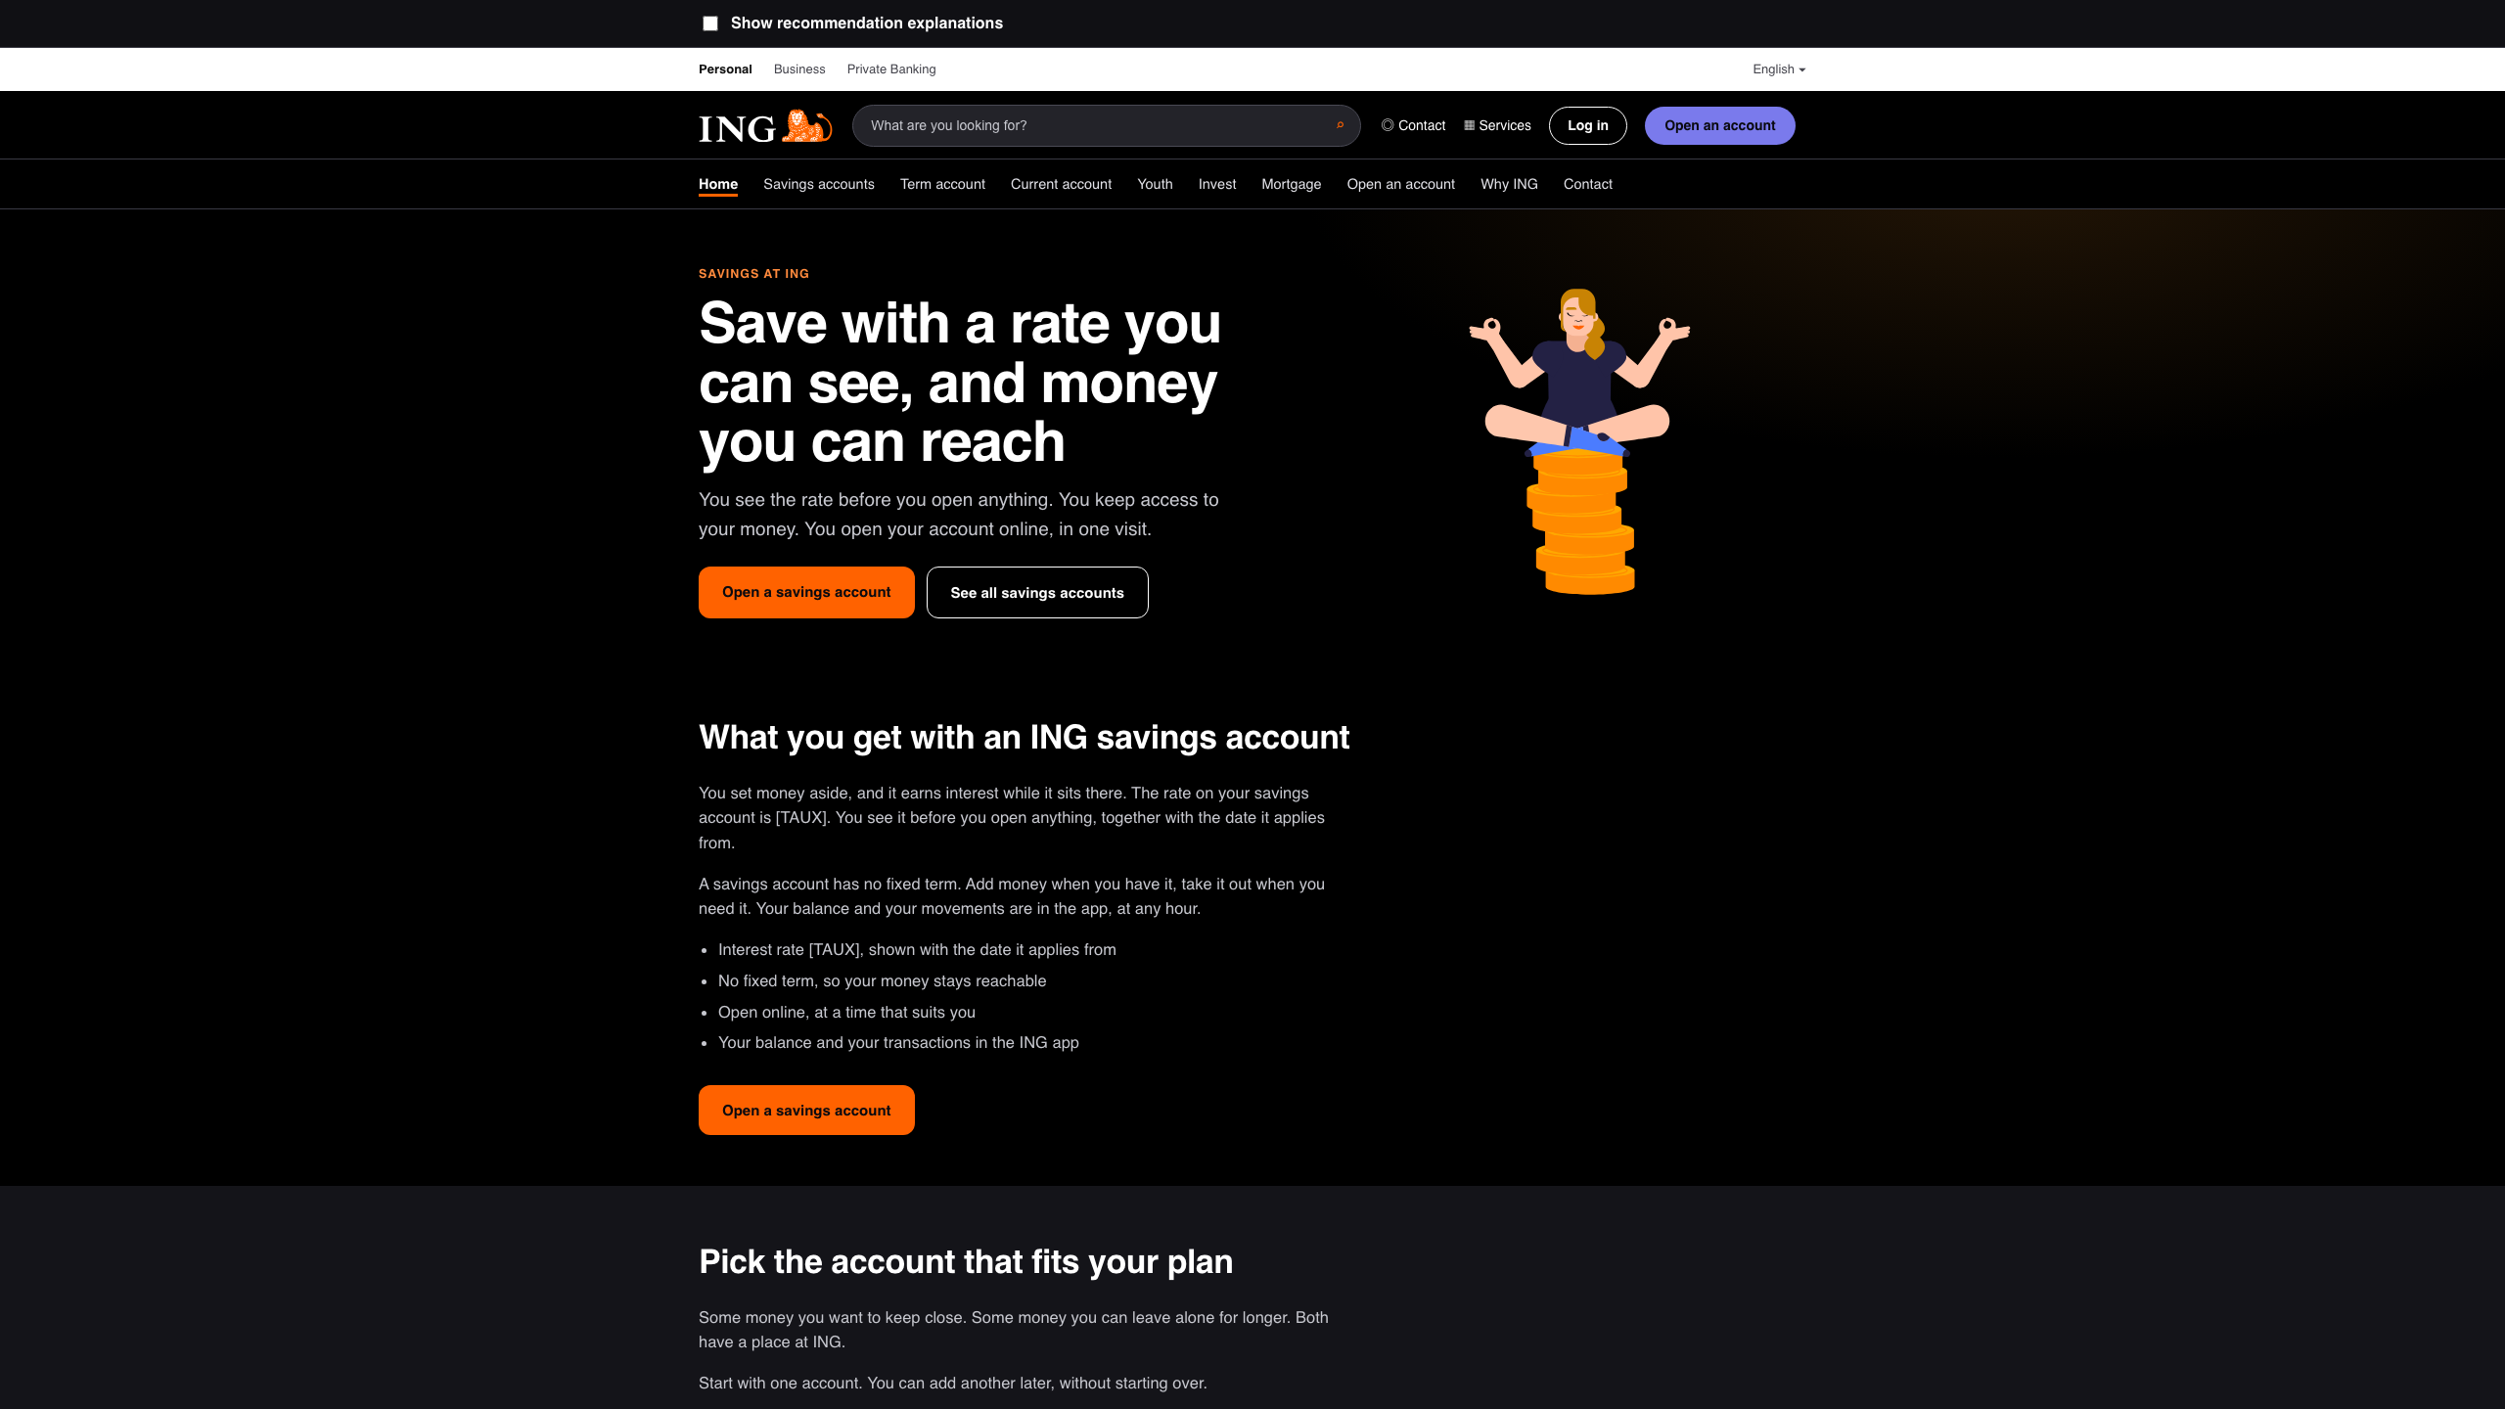
The same site, explanations off
One checkbox above the site hides every box, balloon and rationale — the identical pages, shown as a normal site.
Banking Campaigns Comparator · ING DACI / Customer AI · September 2026
23

Slide 24
The operator tabs, and what they refuse to do
• Six read-only views, moved out of the Streamlit dashboard
Home, Bank profiles, Data, Rubric, Collection and Research now render in the same UI as the findings, from one snapshot the exporter writes: operations.json.
• No pipeline control
Collection is slow and needs a job model, and the robots.txt gate must stay server-side and non-overridable — so there is no 'run collection' button in a browser.
• No dataset or dictionary editing
The dictionary is the frozen contract (P-04); a form that edited it would undo the freeze rule, and a form that edited an extracted feature would destroy its audit trail.
• No live scoring screen
The Rubric tab shows finished sheets only. A screen that displayed a rater's neighbours would make the agreement figure measure visibility, not independent judgement (NFR-05).
• One direction only
The UI does no arithmetic: every number is computed in Python and handed over already labelled, so no figure on screen has a second definition.
The Streamlit file stays in the repository for share.streamlit.io; it is no longer the only place these views exist.
Banking Campaigns Comparator · ING DACI / Customer AI · September 2026
24

Slide 25
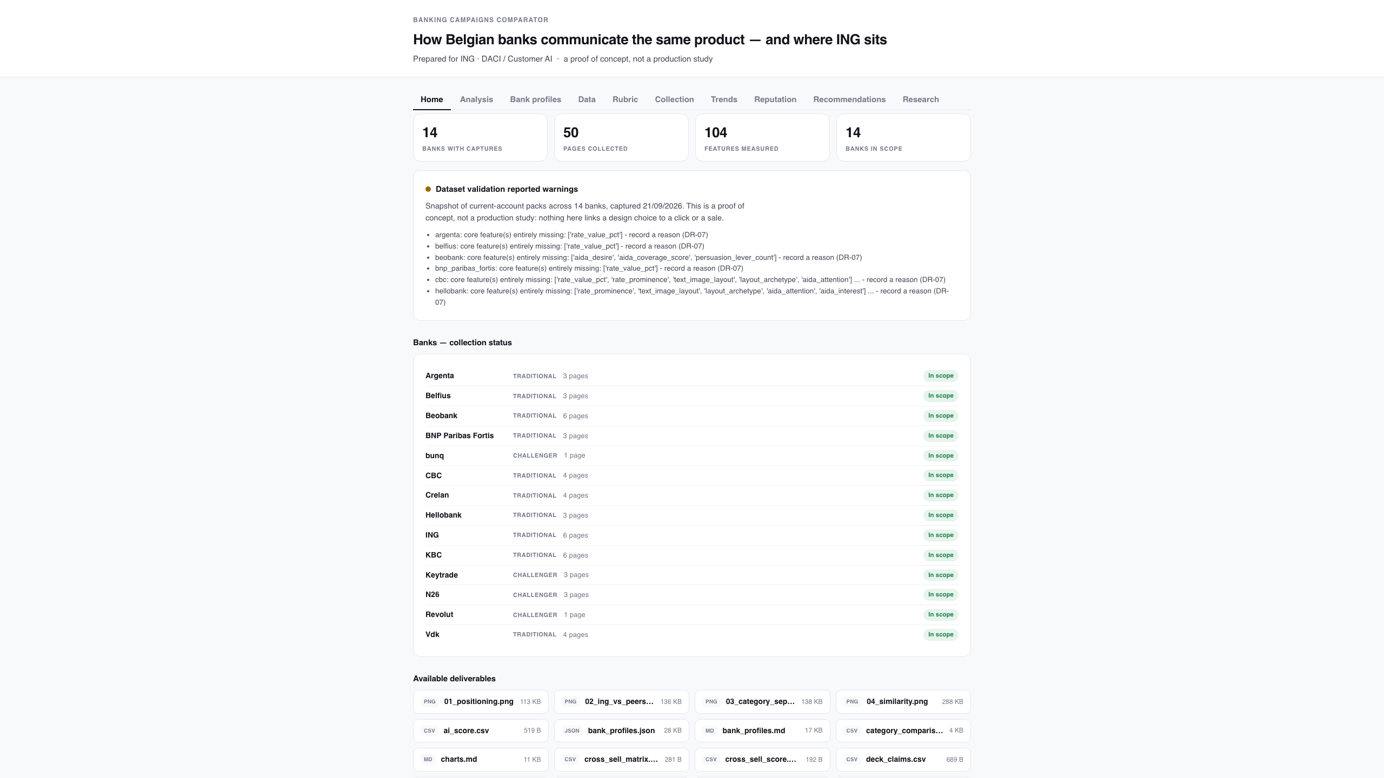
Home: what was collected, and what comes out
Four counts from the run, the validation verdict, every bank's status, and a download per deliverable.
Banking Campaigns Comparator · ING DACI / Customer AI · September 2026
25

Slide 26
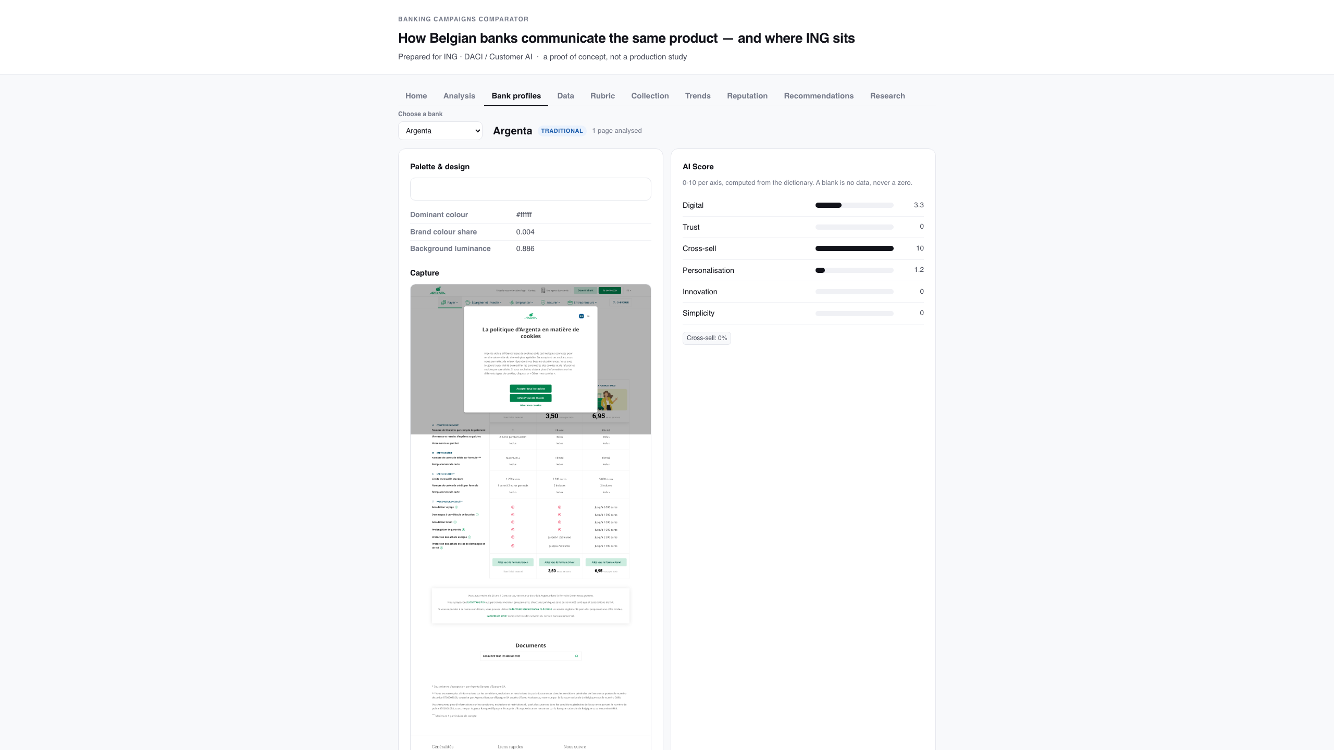
Bank profiles: one bank, every measured field
Palette, tone, imagery, layout, value proposition, the z-score signature, personas and the AI Score.
Banking Campaigns Comparator · ING DACI / Customer AI · September 2026
26

Slide 27
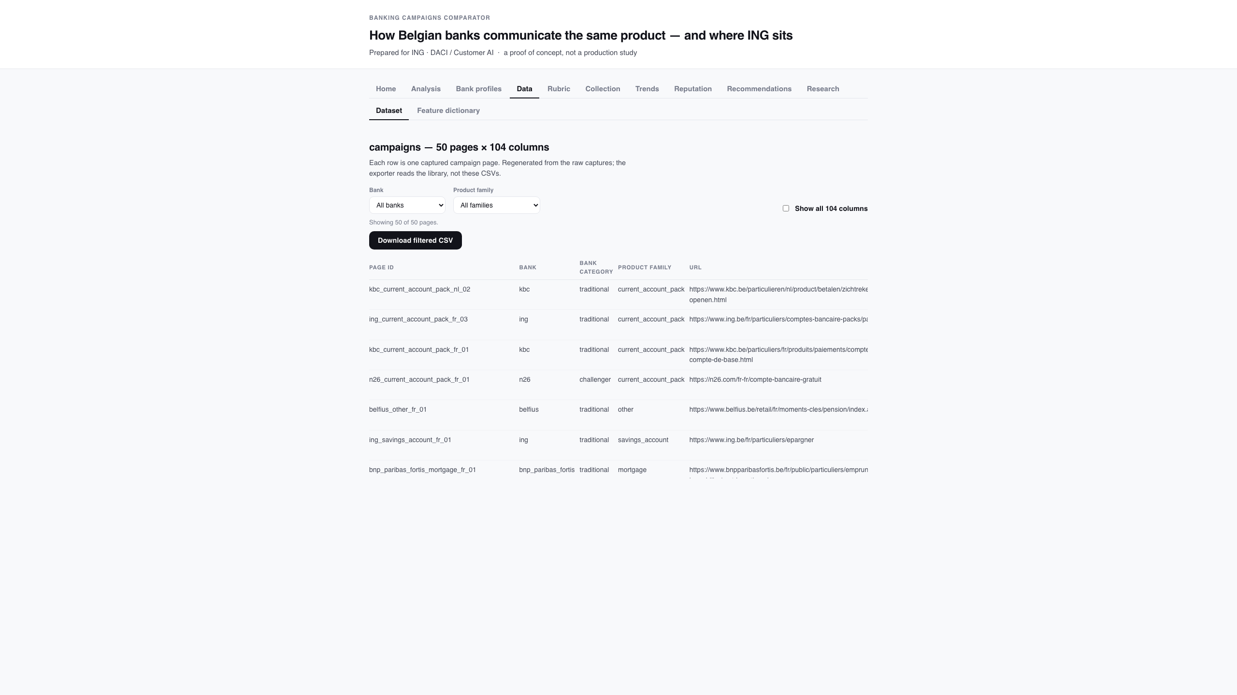
Data: the dataset and the frozen dictionary
Every capture with its provenance, filterable and exportable, read against the 104-feature dictionary.
Banking Campaigns Comparator · ING DACI / Customer AI · September 2026
27

Slide 28
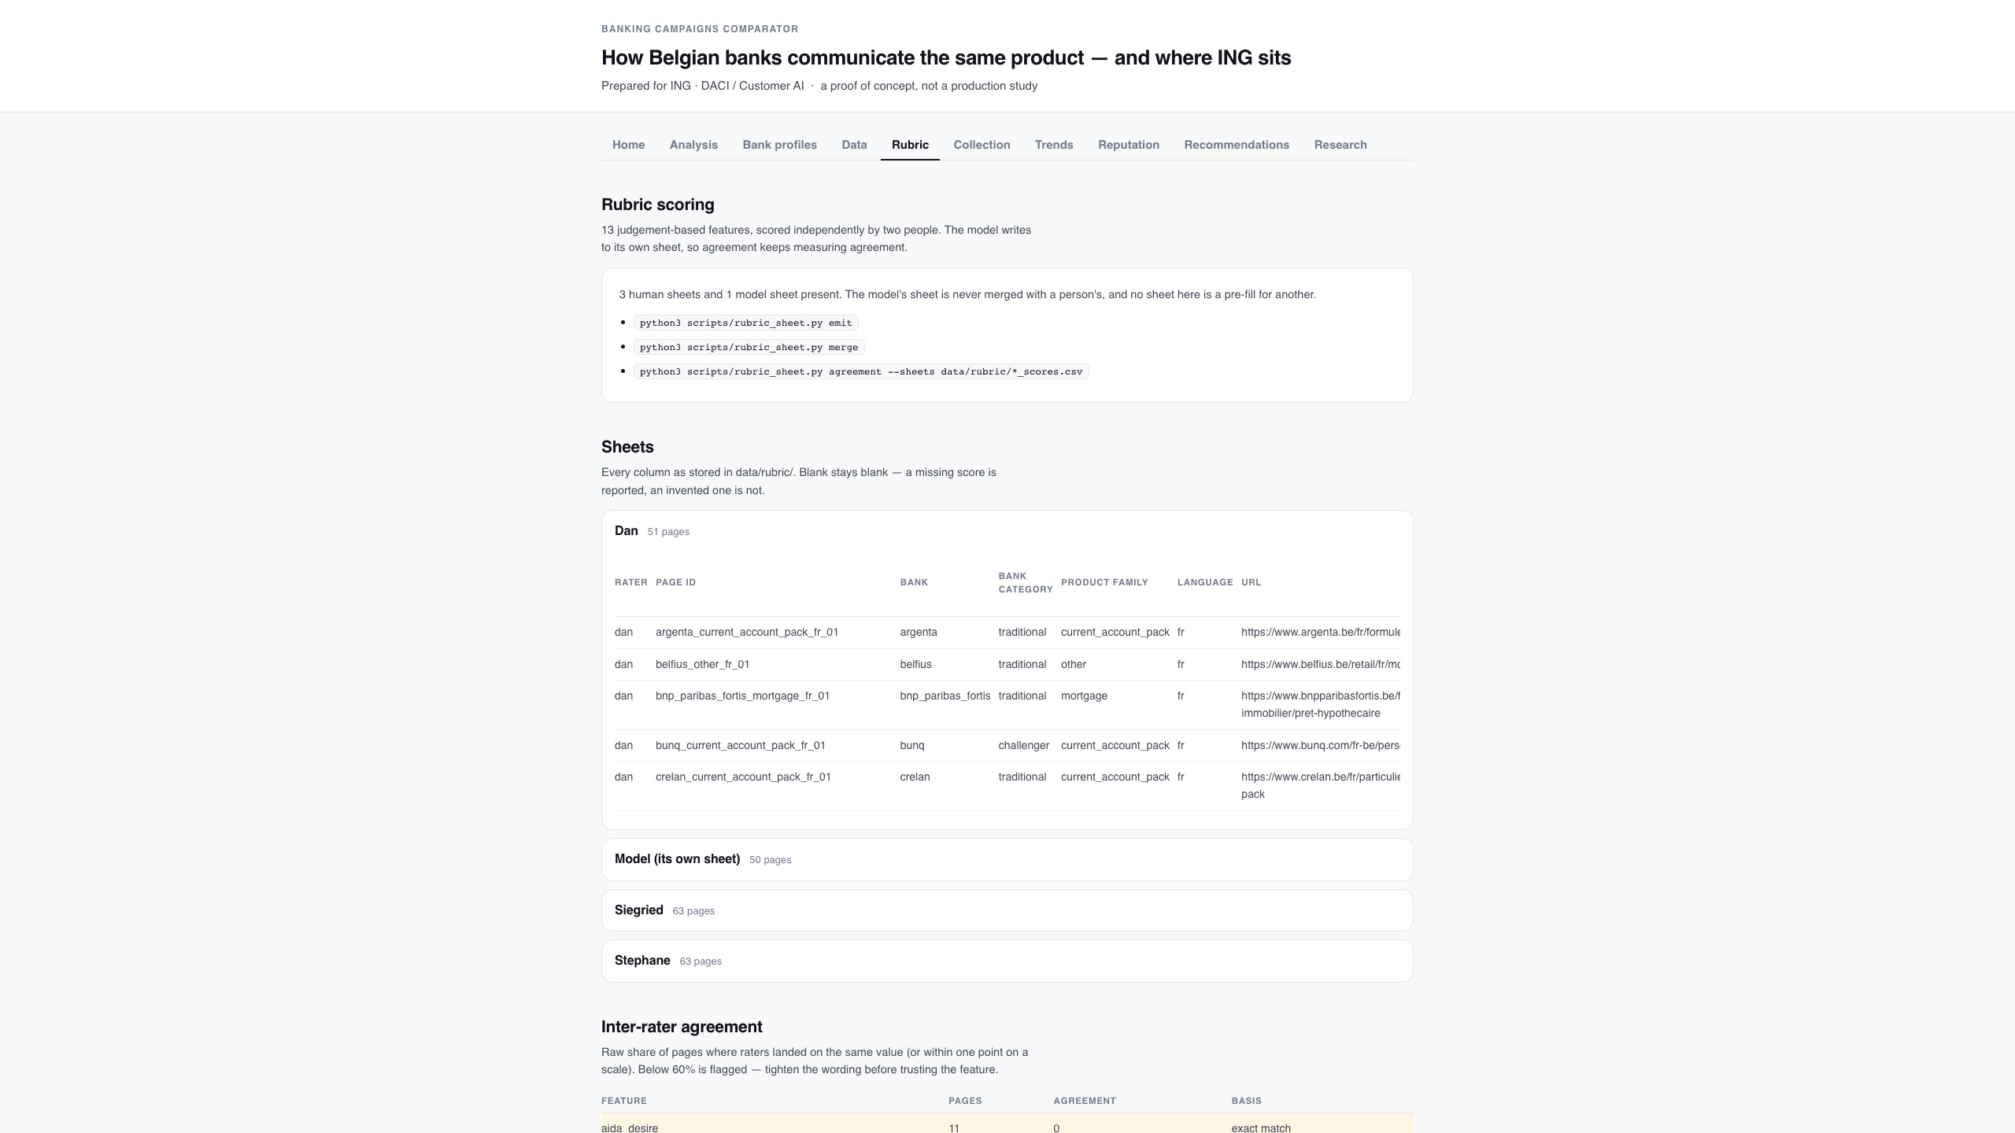
Rubric: the sheets, and where they disagree
Every sheet, raw agreement, chance-corrected kappa, and the scoring guide — never merged into one score.
Banking Campaigns Comparator · ING DACI / Customer AI · September 2026
28

Slide 29
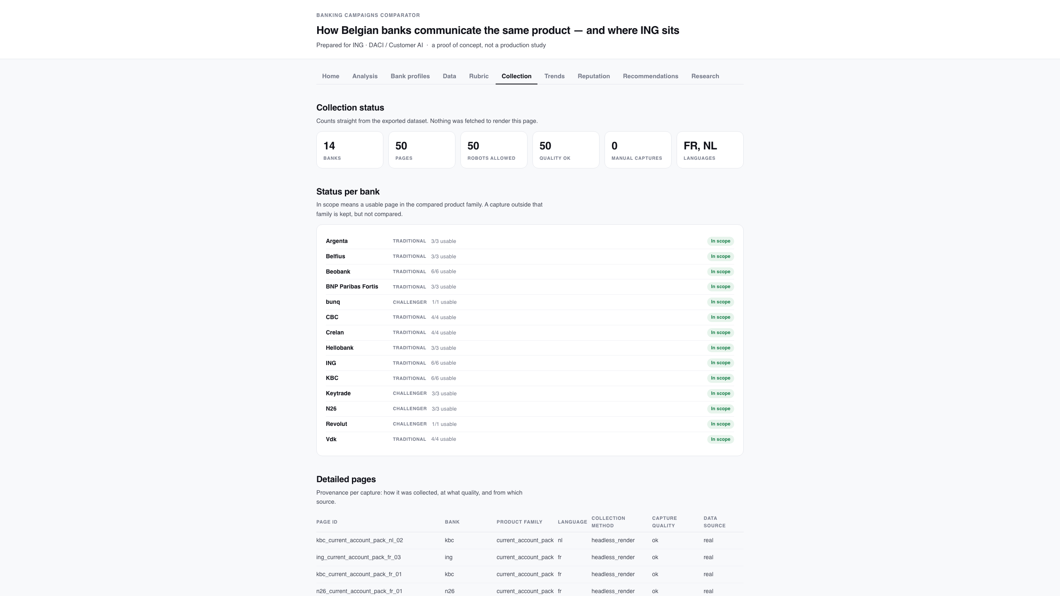
Collection: status, provenance and the pipeline
Counts straight from the export, per-bank status, capture provenance, and the commands that produced it.
Banking Campaigns Comparator · ING DACI / Customer AI · September 2026
29

Slide 30
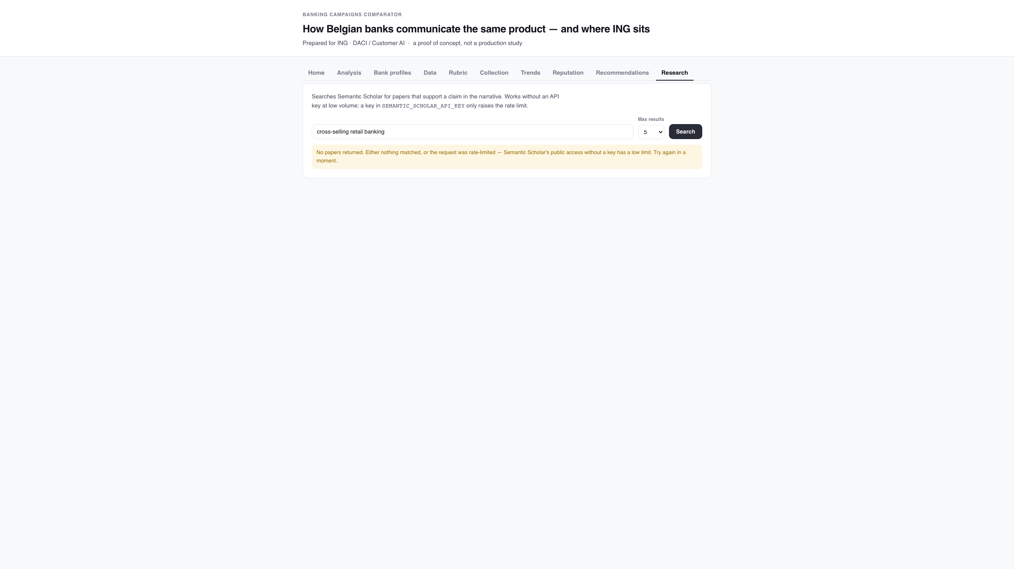
Research: sourcing a claim
Semantic Scholar, on demand. Empty is reported as empty — a rate limit must not read as 'no evidence'.
Banking Campaigns Comparator · ING DACI / Customer AI · September 2026
30

Slide 31
What this cannot support
• No performance data exists here
Nothing links a design choice to a click, a conversion or a sale. Every recommendation is a hypothesis ING could test.
• Small groups, by design
Four challengers against ten traditional banks, and most banks contribute a single page — so a group mean is an anecdote and an effect size describes separation, not significance.
• The judgement features are thinner than they look
Coverage is partial and the overlap between any two raters is still thin, and six of the thirteen features sit below the agreement bar — so a finding resting on persuasion levers or accent placement is a hypothesis.
• Search interest is context, and covers part of the market
It measures what people searched for, not what a campaign achieved, and the pages captured are today's pages.
• Only the open web is covered
Social, in-app and email banners are out of scope — and may be where a bank's real communication happens.
outputs/limitations.md is regenerated from the dataset on every run, so these cannot quietly go stale.
Banking Campaigns Comparator · ING DACI / Customer AI · September 2026
31

Slide 32
Roadmap
• 1. Turn the rubric into a number you can quote
Finish the two-raters-per-bank split — it takes the comparison from 30 usable features to about 40 — and tighten the wording for the six features below the 60% bar before any judged feature carries a finding.
• 2. Fill the remaining sheet rows
Every bank now has its rows, including the two English pages restored on 23/09; what is missing is filled scores, not sheets.
• 3. Re-run and re-export
rubric_sheet.py merge → run_analysis.py → export_web_report.py, then re-verify the narrative's figures against the new snapshot.
• 4. Decide on outputs/ in git
It is regenerated on every run yet tracked, so each analysis leaves a large binary diff.
• 5. Then, if the team wants it
Savings, mortgage, pension, investment and term accounts are already collected (52 pages, 6 families); comparing each family the same way is the next step, plus a wider bank set.
Banking Campaigns Comparator · ING DACI / Customer AI · September 2026
32

Slide 33
Measure one way. Label the trust. Claim only what the data supports.
The pipeline, the contract and the guardrails are in the repository:
README.md · docs/design.md · docs/pipeline.md · web/README.md · docs/decisions.md

